Slide 1
The Saxon Invasion
Week-4

Slide 2
Bede, English Monk
Ecclesiastical History of the English People
After the Roman Invasion, three powerful Germanic tribes invaded Britain: the Saxons, Angles (east and North Midland) and Jutes (Kent and along the south coast)
England, “land of the Angles”

Slide 3
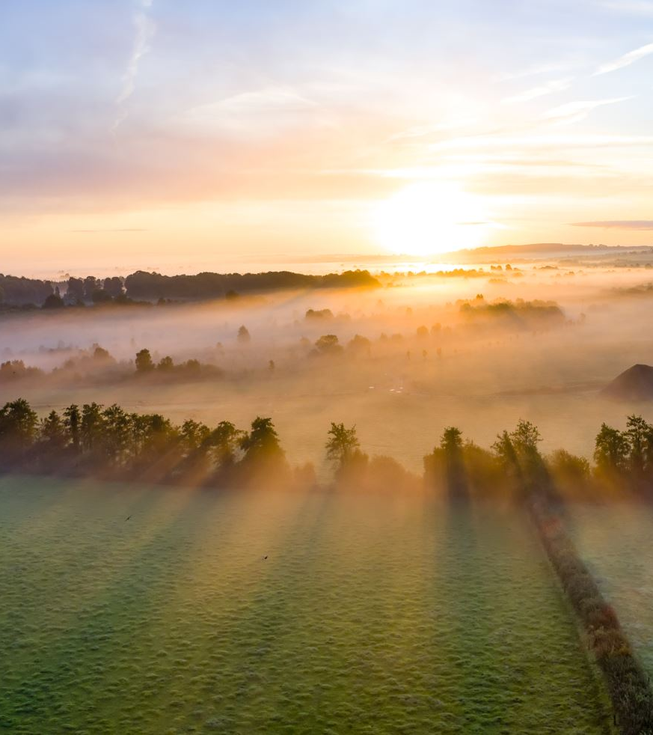
The establishment of kingdoms
Essex, Wessex, Sussex, Middlesex, NORTHUMBRIA, MERCIA, WESSEX..
King Offa of Mercia claimed kingship of the English
King’s power depended on personal loyalty of his followers

Slide 4
The Saxon created institutions..
King’s Council, the Witan
Shires / Counties
Different ploughing techniques
Class division
Manor
Aldermen, earls, the men of learning

Slide 5
The Witan
“The Witan probably grew out of informal groups of senior warriors and churchmen to whom kings like Offa had turned for advice or support on difficult matters. By the tenth century the Witan was a formal body, issuing laws and charters. It was not at all democratic, and the king could decide to ignore the Witan's advice. But he knew that it might be dangerous to do so. For the Witan’s authority was based on its right to choose kings, and to agree the use of the king's laws. Without its support the king's own authority was in danger. The Witan established a system which remained an important part of the king's method of government . Even today, the king or queen has a Privy Council, a group of advisers on the affairs of state”. (p.12)

Slide 6

Shires /Counties (Norman Version)
The term "shire" means a division or district. Shires were originally established as subdivisions of the larger Anglo-Saxon kingdoms.
Shires are administrative units responsible for local governance, law enforcement, and tax collection. They were headed by a local noble or official known as a "shire reeve" or "sheriff," who acted as the king's representative in the shire.

Slide 7
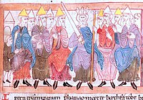
Aldermen
  They were local officials who held administrative and judicial responsibilities within a shire or county.
  They played a crucial role in maintaining order and administering justice within their designated jurisdictions.

Slide 8
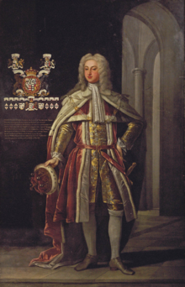
Earls
  Earls were members of the nobility
  They ranked below the king and holding significant territorial authority. The title of earl was hereditary and often granted to individuals with established noble lineage.

Slide 9
Man of Learning
  Educated individuals by monastry
  These individuals were crucial in preserving and disseminating knowledge during a time when education was closely tied to religious institutions.
  Monastic Scholars: Monasteries were the places of learning, and monks were often the primary "men of learning."
  They engaged in the transcription of manuscripts, the study of classical texts, and the preservation of knowledge in various disciplines. (Cultural Influence)
  .

Slide 10
Christianity
Celtic and Roman Church

Slide 11
Celtic church
It was characterized by a distinct monastic tradition, a strong emphasis on individual spirituality
It brought Christianity to the ordinary people.
They established the Monastic Centers to spread Christian teachings and educate the people. Thus, monasticism played a central role, with prominent monastic centers.
Itss monks and missionaries were known for their wandering journeys, spreading the Christian message across the British Isles.

Slide 12
Roman church
Roman Christianity, introduced with the Roman occupation of Britain, became more prominent with the mission of Augustine of Canterbury in 597 AD.
Augustine's arrival marked a significant attempt to align the practices of the existing Celtic Church with those of the Roman Church.
It was interested in authority and organisation.
Roman Church dominated the Britain.

Slide 13
Increase in Church’s authority
1- Conversion and Missionary Activity
2- Monasticism and Centers of Learning
3- Royal Support
4- Land Ownership and Economic Power
5- Integration of Cultural Practices
6- Council Participation

Slide 14
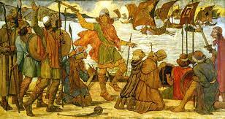
The Vikings
“Pirates”
“The people of the sea inlets”

Slide 15
Timeline
842
Vikings raided and burnt churches and monastries
865
They conquered and settled
They accepted Christianity
875
King Alfred became powerful

Slide 16
Viking rule: the Danelaw vs King Alfred
Walled settlements: burghs

Slide 17
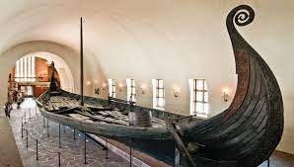
They were skilled carpenters and shipbuilders
One of the most iconic examples of Viking craftsmanship is the Oseberg ship
The Vikings' proficiency in shipbuilding not only facilitated their exploration of faraway places but also facilitated their interaction with other cultures through trade and exploration.
These voyages allowed the Vikings to acquire luxury goods such as spices, silk, and precious metals, which were highly prized in their homeland and served as symbols of wealth and status.
The Vikings’ interactions with other cultures through trade and exploration contributed to the exchange of ideas, technologies, and cultural practices.
They were not ONLY raiders but also skilled traders and diplomats who forged alliances and established diplomatic relations with neighboring societies.

Slide 18
Social Classes in the Viking Society
Jarls | • They were powerful noblemen (the heads of influential families, often joined through marriage). • They were wealthy and generally wore fine clothes and intricate jewellery. • They often lived in large, well-appointed longhouses. • The king depended on their support in order to rule.
Karls | • They were farmers, merchants and craftsmen (such as silversmiths and shipbuilders). • They made up the majority of Viking communities. • They were 'free' people who were loyal to the king or a jarl and paid taxes to them directly. • Many karls took part in raids.
Thralls | • This class consisted of slaves, prisoners of war and criminals - the poorest of the poor. • They performed most of the hard work (e.g. farm labour, cutting wood and stone). • They had no rights under the law, but most were treated well.

Slide 19
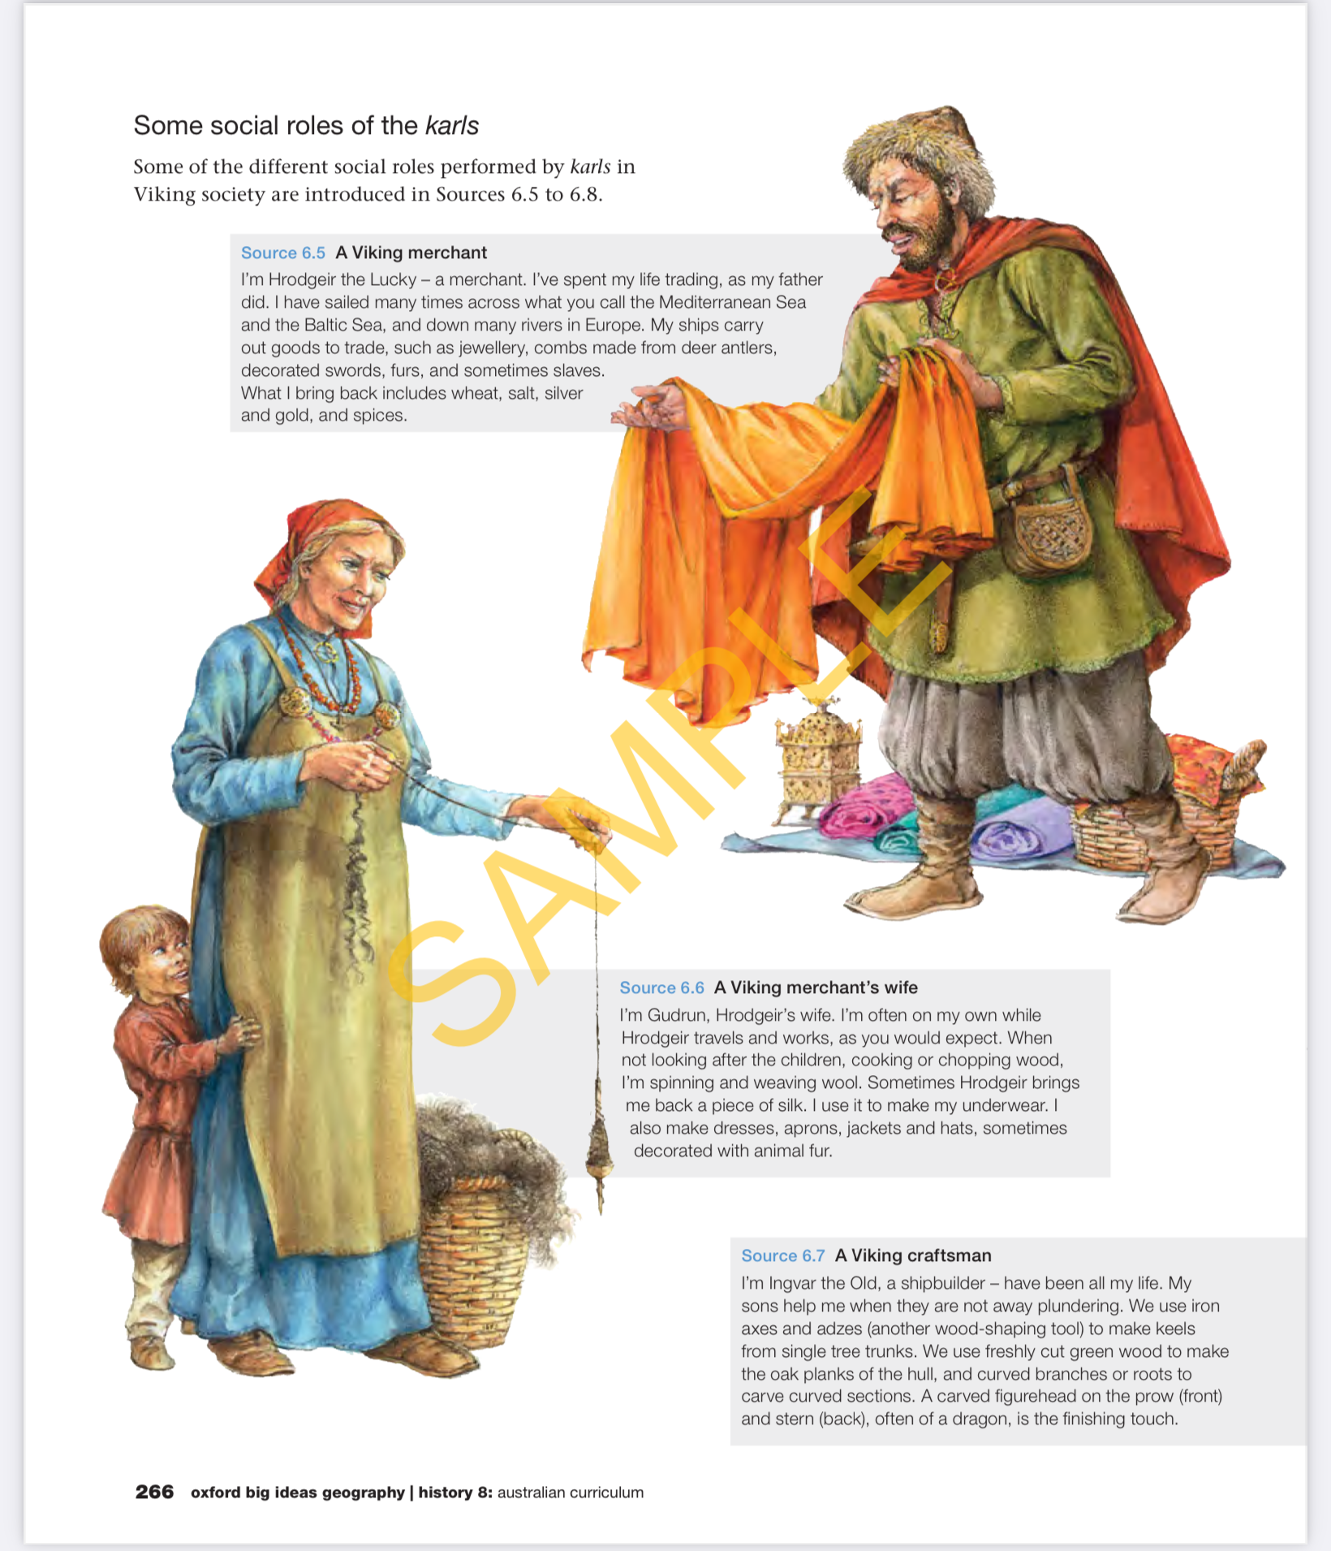

Slide 20
